Slide 1
Digital Logic Design
Imran Siddiqi
Chapter 1c
imran.siddiqi@mcs.edu.pk
Computer Science Department
College of Telecommunication Engineering
National University of Sciences and Technology

Slide 2
Contents
Signed Binary Numbers
BCD & BCD Addition
Weighted Codes
Excess 3 and Gray Codes
Binary Logic

Slide 3
Signed Binary Numbers
It is usual to represent the sign with a bit placed in the leftmost position of the binary number
Sign bit
The Most common notations are:
Signed-magnitude system.
Signed-complement system.
Sign bit 0 positive
Sign bit 1 negative

Slide 4
Signed Magnitude System
Example 1
01001 → + 9
11001 → – 9
Example 2
3-bit binary pattern
Bit Pattern | 000 | 001 | 010 | 011 | 100 | 101 | 110 | 111
Signed-Magnitude Decimal Value | +0 | +1 | +2 | +3 | -0 | -1 | -2 | -3

Slide 5
Signed Complement System
In this system, a negative number is indicated by its complement.
The signed-complement system can use either the 1’s complement or the 2’s complement notations

Slide 6
Example
Assuming the representation of the number 9 in binary with 8-bits, we have the following cases:
Unsigned 9 or +9 has a the same representation in both signed-magnitude and signed-complement systems which is: 00001001
-9 has the signed-magnitude representation: 10001001
-9 has the signed-1’s complement representation: 11110110
-9 has the signed-2’s complement representation: 11110111

Slide 7
Signed Complement System
The signed-complement conversion table of a 3-bit binary pattern is as follows:
Bit Pattern | 000 | 001 | 010 | 011 | 100 | 101 | 110 | 111
Signed 1’s complement decimal value | +0 | +1 | +2 | +3 | -3 | -2 | -1 | -0
Signed 2’s complement decimal value | +0 | +1 | +2 | +3 | -4 | -3 | -2 | -1

Slide 8
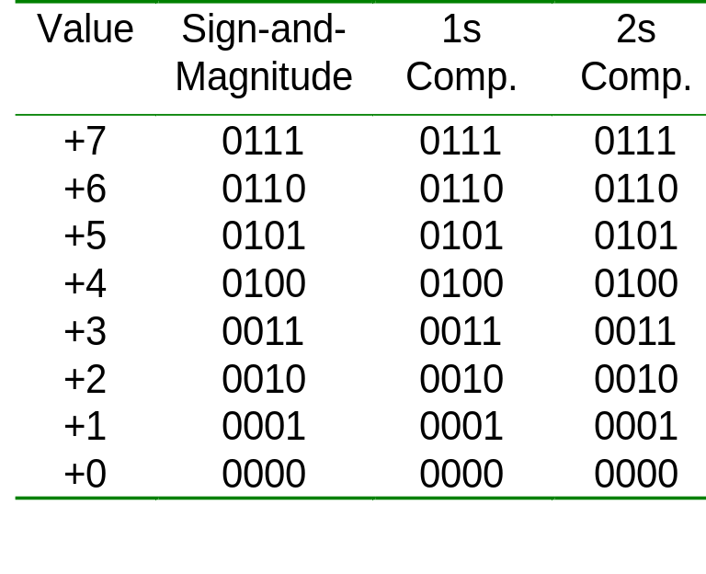
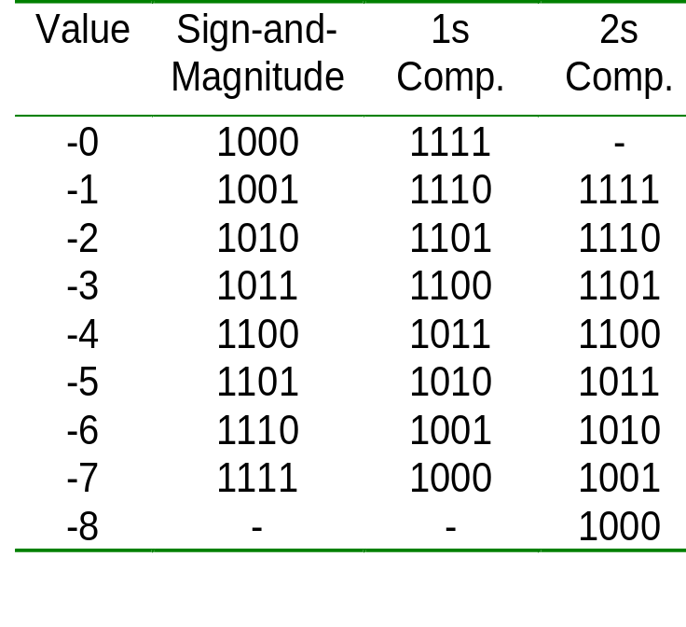
Signed Complement System
4-bit system
Positive values Negative values

Slide 9
Complement of Fractions
We can extend the idea of complement on fractions.
Examples:
  Negate 0101.01 in 1s-complement
  Answer: 1010.10
  Negate 111000.101 in 1s-complement
  Answer: 000111.010
  Negate 0101.01 in 2s-complement
  Answer: 1010.11

Slide 10
Binary Codes

Slide 11
The 8421 BCD
BCD stands for Binary-Coded Decimal.
A BCD number is a four-bit binary group that represents one of the ten decimal digits 0 through 9
Decimal Digit | 0 | 1 | 2 | 3 | 4 | 5 | 6 | 7 | 8 | 9
BCD | 0000 | 0001 | 0010 | 0011 | 0100 | 0101 | 0110 | 0111 | 1000 | 1001
Note: 1010, 1011, 1100, 1101, 1110, and 1111 are INVALID CODE!

Slide 12
BCD
Example:
Decimal number 4926 4 9 2 6
8421 BCD coded number 0100 1001 0010 0110

Slide 13

Question
Convert the BCD coded number
1000 0111 0001 into decimal.
BCD Coded Number 1000 0111 0001
Decimal Number 8 7 1

Slide 14
BCD
People understand decimal system better
BCD makes it easy to replace a decimal number with an individual binary code
Decimal 15 is BCD 0001 0101 in Binary it was 1111
Since most computers store data in eight-bit bytes
  Ignore 4 extra bits
  One can store two digits per byte, called "packed" BCD

Slide 15
BCD Addition
BCD is a numerical code and can be used in arithmetic operations. Here is how to add two BCD numbers:
  Add the two BCD numbers, using the rules for basic binary addition.
  If a 4-bit sum is equal to or less than 9, it is a valid BCD number.
  If a 4-bit sum > 9, or if a carry out of the 4-bit group is generated it is an invalid result. Add 6 (0110) to a 4-bit sum in order to skip the six the invalid states and return the code to 8421. If a carry results when 6 is added, simply add the carry to the next 4-bit group.

Slide 16
BCD Addition - Examples
4+5
 | 0 | 1 | 0 | 0
+ | 0 | 1 | 0 | 1
 | 1 | 0 | 0 | 1
4+8
 | 0 | 1 | 0 | 0
+ | 1 | 0 | 0 | 0
 | 1 | 1 | 0 | 0
Sum is greater than 1001
+ | 0 | 1 | 1 | 0
1 | 0 | 0 | 1 | 0
Add 0110

Slide 17
BCD Addition - Examples
184+576
 |  |  |  | 1 |  |  |  |  | 1
 | 0 | 0 | 0 | 1 |  | 1 | 0 | 0 | 0 |  | 0 | 1 | 0 | 0
+ | 0 | 1 | 0 | 1 |  | 0 | 1 | 1 | 1 |  | 0 | 1 | 1 | 0
 | 0 | 1 | 1 | 1 | 1 | 0 | 0 | 0 | 0 |  | 1 | 0 | 1 | 0
 |  |  |  |  |  | 0 | 1 | 1 | 0 | + | 0 | 1 | 1 | 0
 | 0 | 1 | 1 | 1 |  | 0 | 1 | 1 | 0 |  | 0 | 0 | 0 | 0
184
576
760

Slide 18
The Excess-3 Code
Add 3 to each digit of decimal and convert to 4-bit binary form
Decimal Binary +3 Excess-3
0 0000 0011 0011
1 0001 0011 0100
2 0010 0011 0101
3 0011 0011 0110
4 0100 0011 0111
5 0101 0011 1000
6 0110 0011 1001
7 0111 0011 1010
8 1000 0011 1011
9 1001 0011 1100
Sample Problem:
Decimal 3 5 9
Excess-3 0110 1000 1100

Slide 19
Self Complementing Codes
The codes representing the pair of complementary digits are also complementary to each other.
Example: Excess-3 code
0: 0011
1: 0100
2: 0101
3: 0110
4: 0111
5: 1000
6: 1001
7: 1010
8: 1011
9: 1100

Slide 20
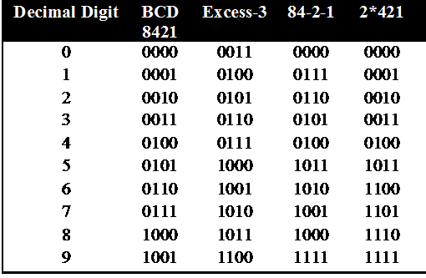
Some Weighted Codes
Weight codes – Different position has different weight
8421 code 0101=0x8+1x4+0x2+1x1=5
84-2-1 0101=0x8+1x4+0x(-2)+1x(-1)=3

Slide 21
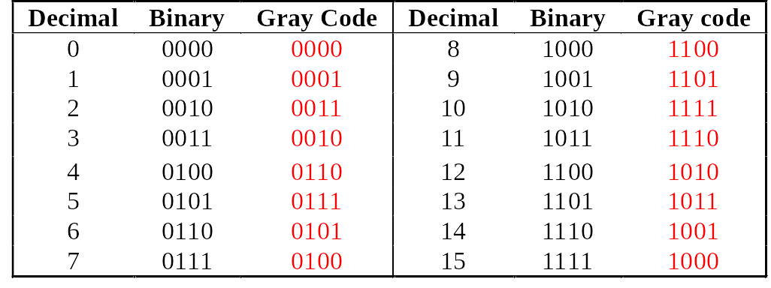
The Gray Code
Unweighted Code
Only a single bit change from one code value to the next.
Example: 4-bit standard Gray code

Slide 22
Table 1.9 Nonweighted Codes
Decimal Excess-3 code Gray code
0 0011 0000
1 0100 0001
2 0101 0011
3 0110 0010
4 0111 0110
5 1000 0111
6 1001 0101
7 1010 0100
8 1011 1100
9 1100 1101
10 1111
11 Not 1110
12 defined 1010
13 1011
14 1001
15 1000

Slide 23

Warning: Conversion or Coding
Do NOT mix up conversion of a decimal number to a binary number with coding a decimal number with a BINARY CODE.
13₁₀ = 1101₂ (This is conversion)
13 ⇔ 0001|0011 (This is coding)

Slide 24
Character Codes - ASCII
Many applications require handling of not only numbers but letters and special characters
ASCII – American Standard Code for Information Interchange
7 Bits to store 128 characters
In ASCII, every letter, number, and punctuation symbol has a corresponding number, or ASCII code

Slide 25
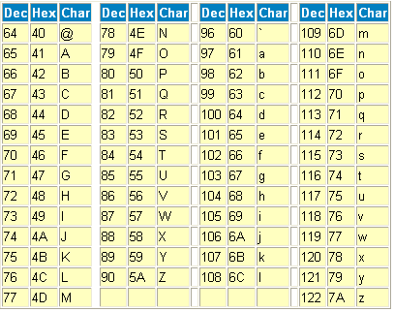
ASCII Table

Slide 26
Error Detection
Errors can occur during data transmission. They should be detected, so that re-transmission can be requested.
With binary numbers, usually single-bit errors occur.
  Example: 0010 erroneously transmitted as 0011 or 0000 or 0110 or 1010.

Slide 27
Even Parity
Even parity – set bit to make number of 1’s even
Examples
  1000001 with even parity is 01000001
  1000011 with even parity is 11000011

Slide 28
Odd Parity
Similar except make the number of 1’s odd
Examples
  1000001 with odd parity is 11000001
  1000011 with odd parity is 01000011

Slide 29
Error Detection
Parity bit can detect odd number of errors but not even number of errors.
  Example: Assume odd parity,
    10011 → 10001 (detected)
    10011 → 10101 (not detected)

Slide 30
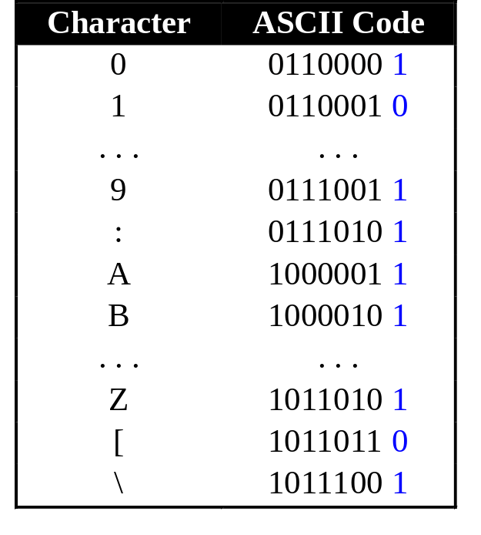
Error Detection
Parity bit
  Even parity: additional bit added to make total number of 1’s even.
  Odd parity: additional bit added to make total number of 1’s odd.
Example of odd parity on ASCII values.
Parity bits

Slide 31

Reading Assignment
Binary Storage and Registers

Slide 32
Binary Logic
Binary logic consists of binary variables and a set of logical operations.
The binary variables can have only two values:0 and 1.
The basic logical operations are AND, OR, and NOT.
For x and y binary variables the three logical operations are shown as:
  AND operation . x.y
  OR operation + x+y
  NOT operation ' x'

Slide 33
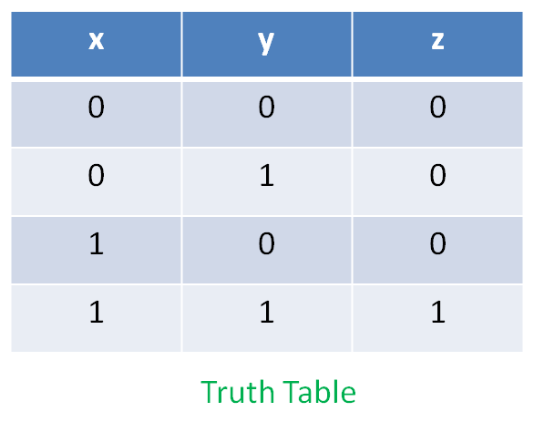
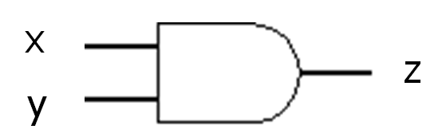
The AND Operation
The circuit represents AND operation and is called AND gate
Two or more input bits produce one output bit.
Both inputs must be true (1) for the output to be true.
Otherwise the output is false (0).

Slide 34
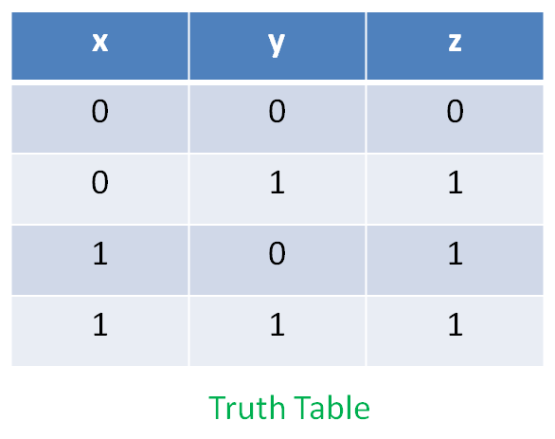
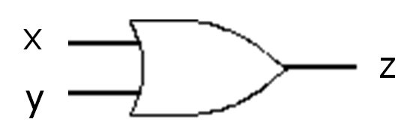
The OR Operation
The circuit represents OR operation and is called OR gate
Two or more input bits produce one output bit.
Either inputs must be true (1) for the output to be true.

Slide 35
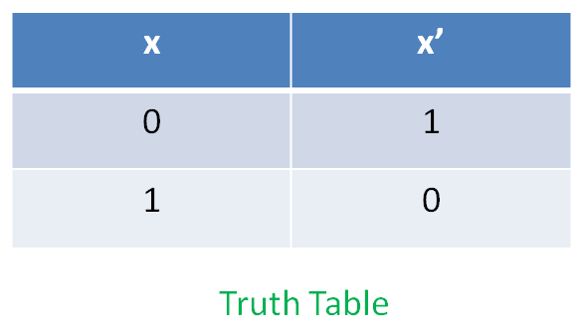
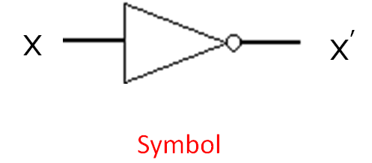
The NOT Operation - Inverter
The circuit represents NOT operation and is called NOT gate or INVERTER
One bit as input produces its opposite as output.

Slide 36
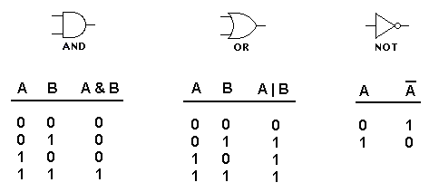
Truth Tables of Logic Operations

Slide 37
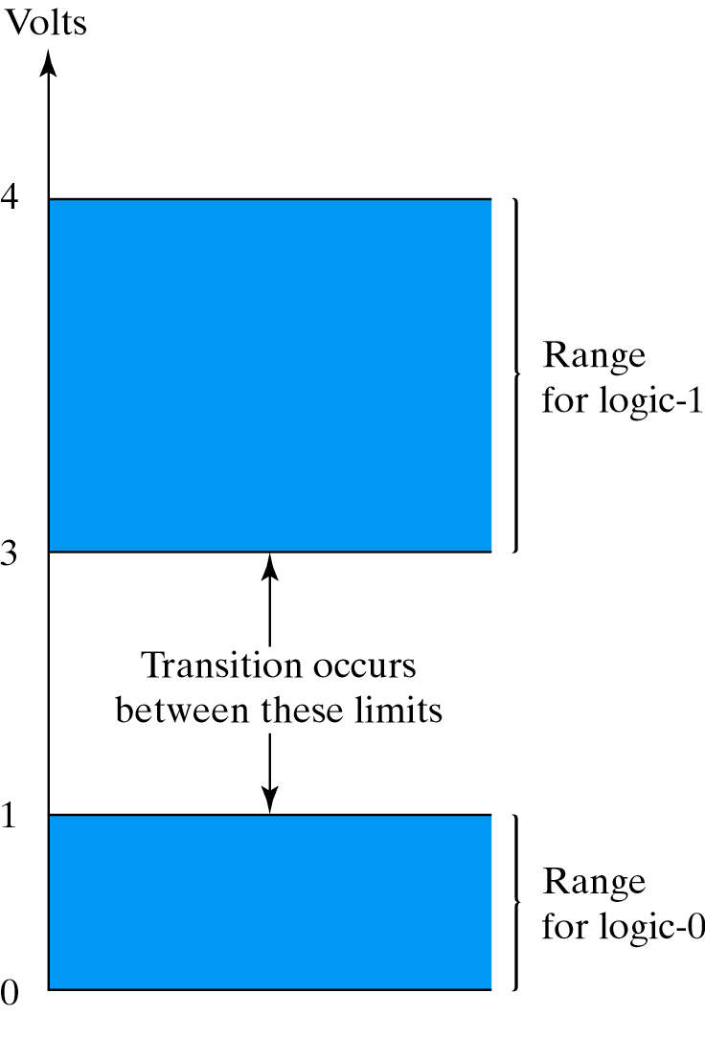
Representation of Binary variables
Different Digital Systems represent 0 and 1 differently
  Logical 0 as 0 volts. Logical 1 as 4 volts
  Range

Slide 38
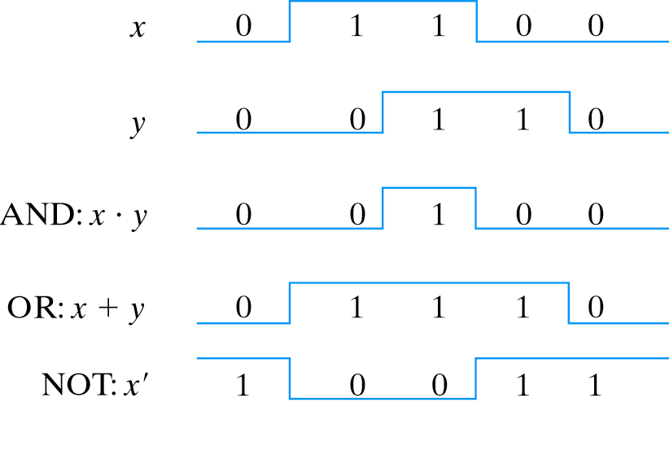
Binary Logic Functions

Slide 39
References
Chapter 1 – Digital Design Morris Mano
Digital Logic and Computer Design – M. Singh, University of North Carolina
Digital Design – O. Ozturk, Bilknet University
Material in these slides has been taken from, the following resources

